Slide 1
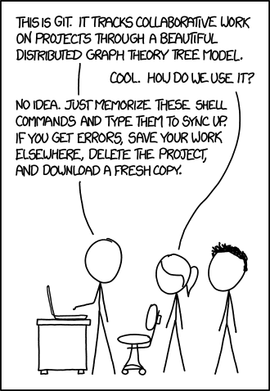
git demystified
http://git-scm.com/book

Slide 2
Good Old Days
file_golden.txt
file_new.txt
file.txt
file_demo.txt
file2.txt
file_11_nov.txt
file_newest.txt
file_temp.txt
file_final.txt
file2.1.txt

Slide 3
VCS simplifies it
Meta Data
Author
Date
Change Log
file_golden.txt
file_final.txt
file2.1.txt
file_11_nov.txt
file2.txt
file_temp.txt
file_demo.txt
file1.txt
file_new.txt
file.txt

Slide 4
How Git Does It
commit f5201…
Project (state 3)
Project (state 5)
Project (state 2)
Project (state 4)
Project (state 1)

Slide 5
How Git Does It
Pro Git Book – Chapter 1.3
Snapshots, Not Differences
The major difference between Git and any other VCS (Subversion and friends included) is the way Git thinks about its data. Conceptually, most other systems store information as a list of file-based changes. These systems (CVS, Subversion, Perforce, Bazaar, and so on) think of the information they keep as a set of files and the changes made to each file over time.
Git doesn’t think of or store its data this way. Instead, Git thinks of its data more like a set of snapshots of a mini filesystem. Every time you commit, or save the state of your project in Git, it basically takes a picture of what all your files look like at that moment and stores a reference to that snapshot.

Slide 6
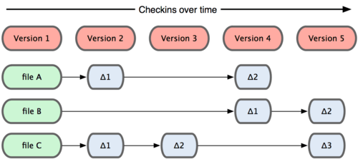
How SVN Does It

Slide 7
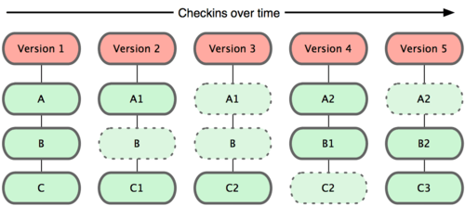
How Git Does It

Slide 8
Git basics
$ git config --global user.name “Shiraz Hashim”
$ git config --global user.email “shashim@codeaurora.org”

Slide 9
Git basics
~/.gitconfig
[user]
name = Shiraz Hashim
email = shashim@codeaurora.org
[color]
diff = auto
status = auto
branch = auto

Slide 10
Git Objects
blob is used to store file data - it is generally a file.
tree is basically like a directory - it references a bunch of other trees and/or blobs (i.e. files and sub-directories)
commit points to a single tree, marking it as what the project looked like at a certain point in time.
tag is a way to mark a specific commit as special in some way.

Slide 11
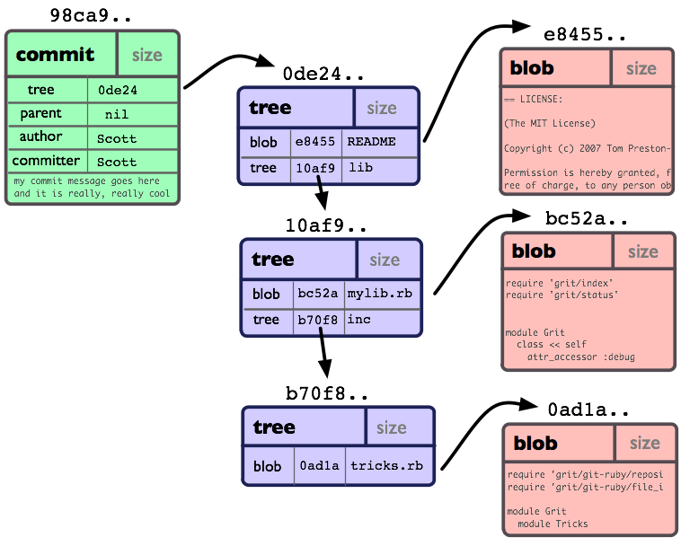
Git Objects

Slide 12
git init
$ mkdir test
$ cd test
$ git init
Initialized empty Git repository in /tmp/test/.git/
$ find .git/objects
.git/objects
.git/objects/info
.git/objects/pack
$ find .git/objects -type f
$

Slide 13
git init
$ echo “version 1” >> test.txt
$ git add test.txt
$ git commit -m ”first commit”
$ find .git/objects/ -type f
.git/objects/24/ca3ccc2dffc677a5db8b9c0e943610fb137e70
.git/objects/83/baae61804e65cc73a7201a7252750c76066a30
.git/objects/d8/329fc1cc938780ffdd9f94e0d364e0ea74f579

Slide 14
git objects
$ git cat-file -p 24ca3ccc
$ git cat-file -p d8329fc1
$ git cat-file -p 83baae61

Slide 15
git objects
$ echo “version 2” >> test.txt
$ echo “new file” >> new.txt
$ git add test.txt new.txt
$ git commit -m ”second commit”
$ # retrive version1 of test.txt
$ # mkdir bak, and
$ # cp test.txt to bak/
$ git add bak
$ git commit –m “third commit”

Slide 16
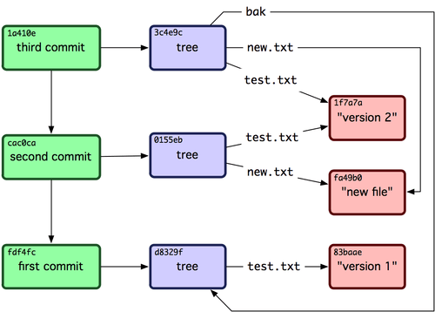
git objects

Slide 17

Trees in Git
Repository
Index
Working Directory
last commit
Proposed Commit
Sandbox

Slide 18
Git Index/Staging Area
.git/index
git ls-files --stage

Slide 19
Git Working Area
File system view
Shell commands and tools like cat, vim, rm work here

Slide 20
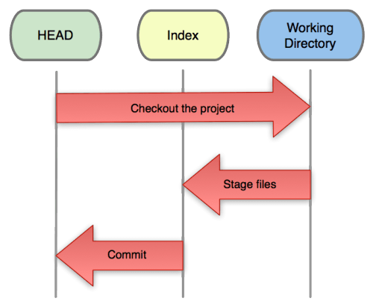
Git Workflow

Slide 21
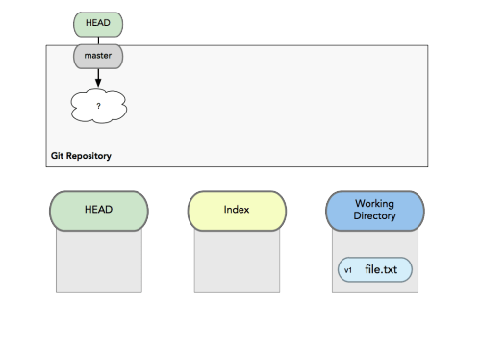
Git Workflow

Slide 22
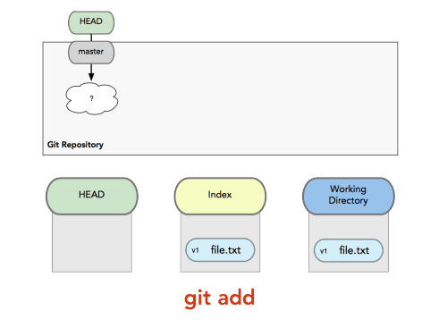
Git Workflow

Slide 23
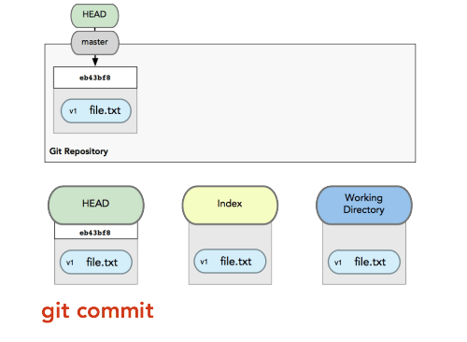
Git Workflow

Slide 24
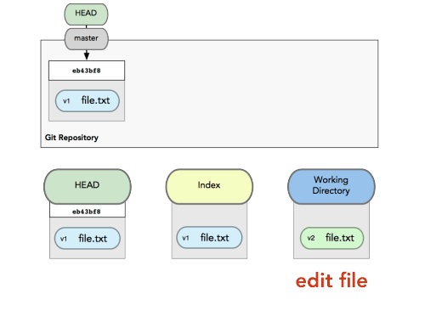
Git Workflow

Slide 25
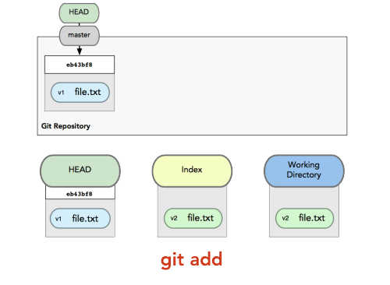
Git Workflow

Slide 26
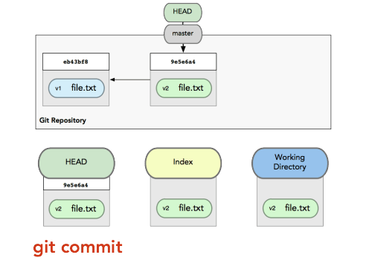
Git Workflow

Slide 27
git init (once again)
Revisit finer details
.git/refs/heads
.git/HEAD

Slide 28
git clone
Clone a repository into a new directory
Clones a repository into a newly created directory, creates remote-tracking branches for each branch in the cloned repository (visible using git branch -r), and creates and checks out an initial branch that is forked from the cloned repository’s currently active branch.

Slide 29
git clone
What if I copy directory, instead of clone ?
What if I copy .git/ only ?
What is remote repository in git ?
What happens on git fetch ?
What happens on git push ?

Slide 30
Trees in Git
Repository
Index
Working Directory
last commit
Proposed Commit
Sandbox

Slide 31
git status
Summarizes difference status, if
Repository and Index Area differ
Index Area and Working Area differ
$ git status
# On branch master
# Changes to be committed:
# (use "git reset HEAD <file>..." to unstage)
#
# modified: test.txt
#
# Changes not staged for commit:
# (use "git add <file>..." to update what will be committed)
# (use "git checkout -- <file>..." to discard changes in working directory)
#
# modified: new.txt
#

Slide 32
git diff
Difference between
Working Area and Index Area
git diff
Index Area and Repository
git diff --cached
Working Area and Repository
git diff HEAD
2 states (i.e. 2 commits)
git diff A..B

Slide 33
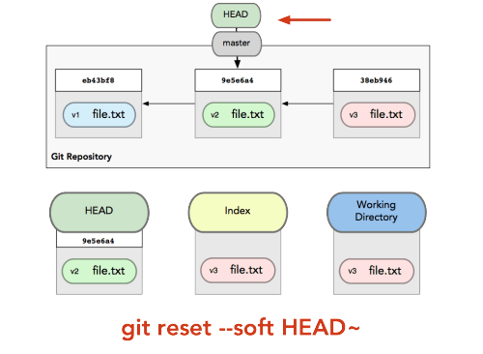
git reset

Slide 34
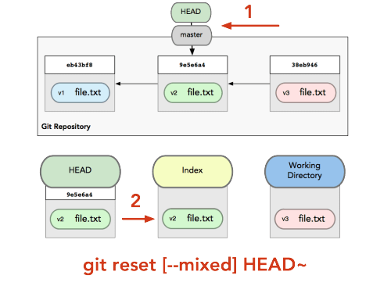
git reset

Slide 35
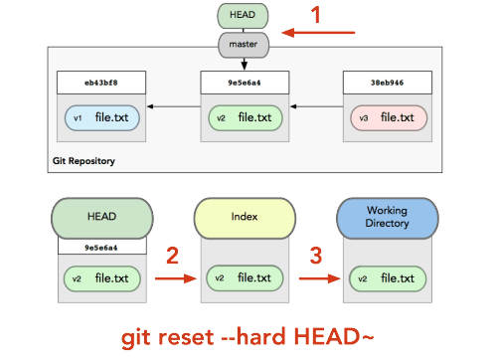
git reset

Slide 36
git reset Overview
Move whatever branch HEAD points to (stop if --soft)
THEN, make the Index look like that (stop here unless --hard)
THEN, make the Working Directory look like that

Slide 37
git reset path
Move whatever branch HEAD points to (stop if --soft)
THEN, make the Index look like that (stop here unless --hard)
THEN, make the Working Directory look like that

Slide 38
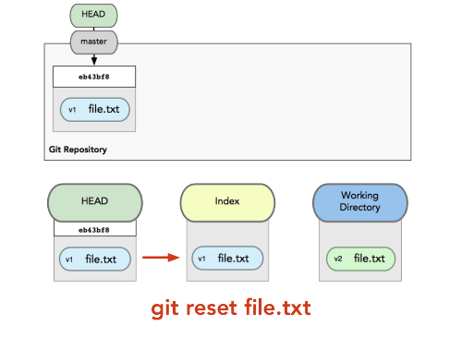
git reset <path>

Slide 39
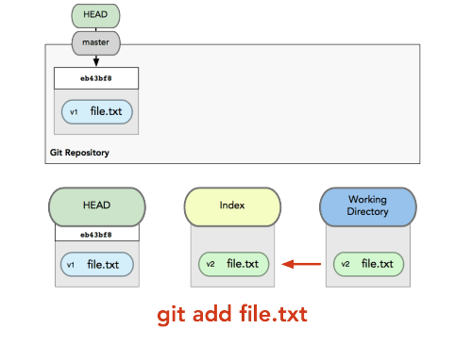
git reset <path>

Slide 40
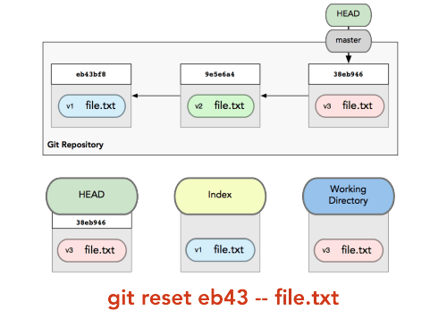
git reset <path>

Slide 41
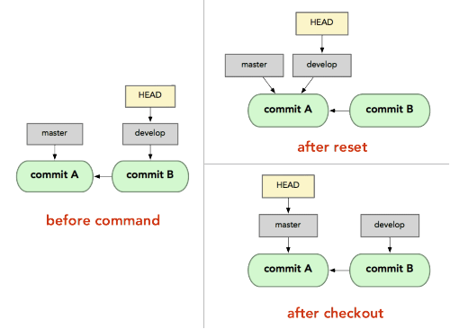
Git Checkout vs Reset

Slide 42
Git Checkout vs Reset (for Path)
Both update the index with that file at that commit
Checkout also overwrites the file in the working directory
Think of checkout like
git reset --hard [branch] file
reset with a file name does not accept --hard

Slide 43
Summary
 | HEAD | Index | Work Dir | Work Dir Safe
Commit Level
reset –soft [commit] | Yes +Ref | No | No | Yes
Reset [commit] | Yes +Ref | Yes | No | Yes
reset –hard [commit] | Yes +Ref | Yes | Yes | No
checkout [commit] | Yes | Yes | Yes | Yes
File Level
reset commit file | No | Yes | No | Yes
checkout commit file | No | Yes | Yes | No

Slide 44
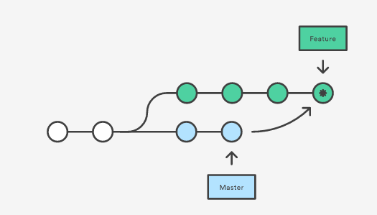
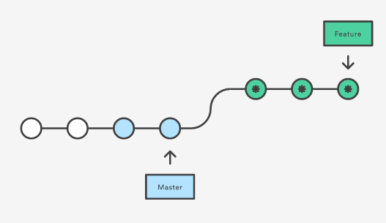
git merge/rebase
$ git checkout feature
$ git merge master
$ git checkout feature
$ git rebase master

Slide 45
Questions
???

Slide 46
Questions
How do I unstage changes ?
How do I undo changes in my working directory
How do I go back to a file from previous revision
How do I squash topmost commits (not using rebase –i)

Slide 47
Backup

Slide 48
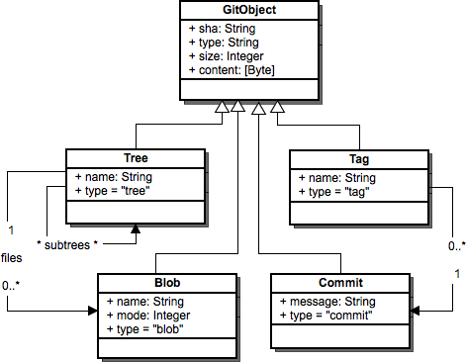
Git Objects

Slide 49
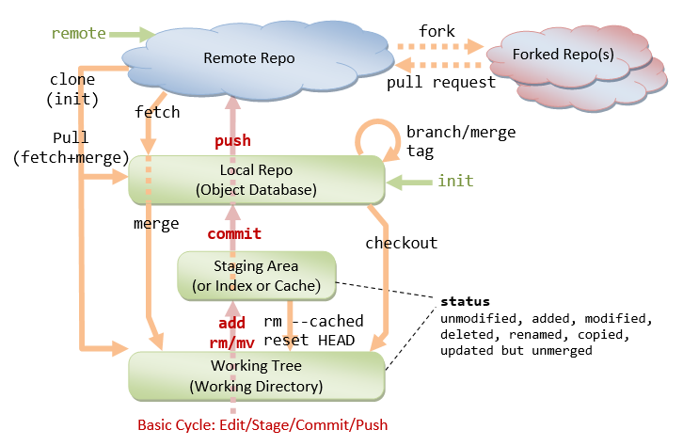
Distributed Development

Slide 50
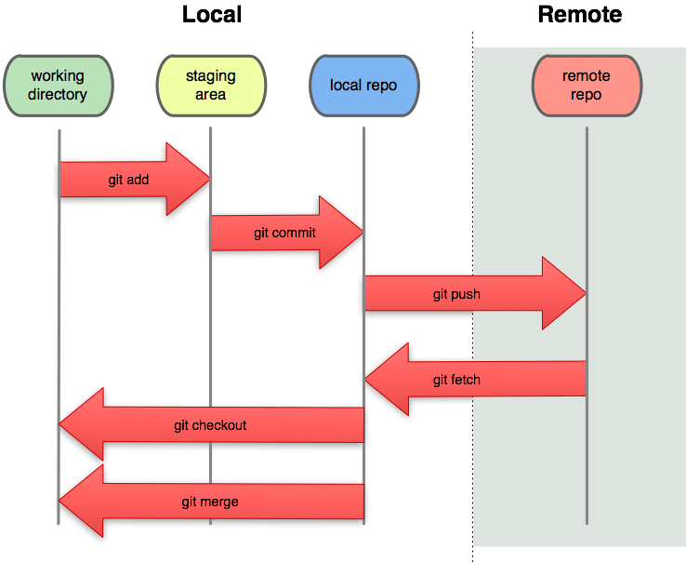
Distributed Development

